Slide 1

IPG for Distributed Beamforming

Slide 2
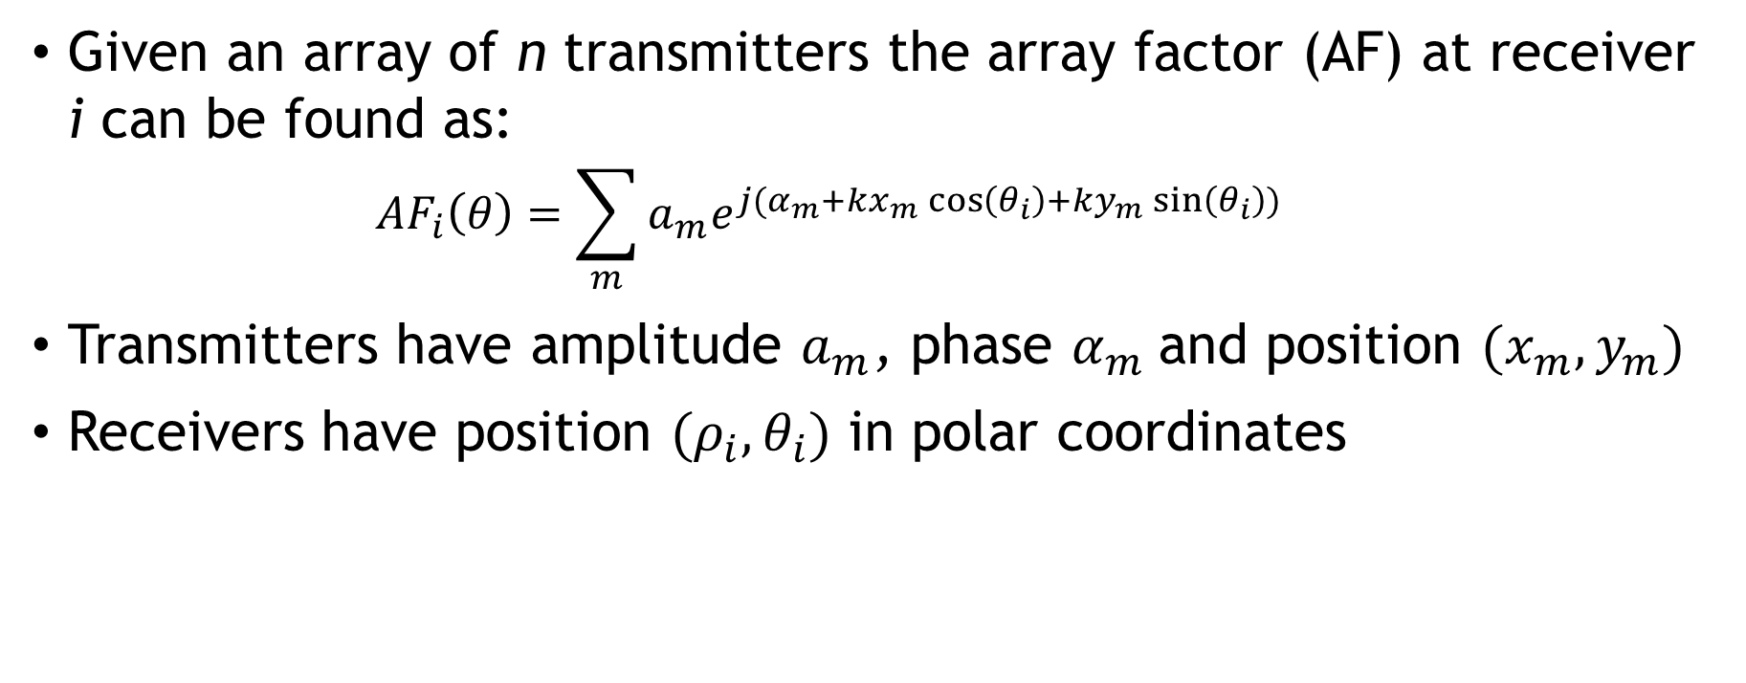
Background - Beamforming
Given an array of n transmitters the array factor (AF) at receiver i can be found as:
$$AF_{i}\left(θ\right)=\sum_{m}{a_{m}e^{j(α_{m}+kx_{m}\cos\left(θ_{i}\right)+ky_{m}\sin\left(θ_{i}\right))}}$$
Transmitters have amplitude $a_{m}$, phase $α_{m}$and position $(x_{m}, y_{m})$
Receivers have position $(ρ_{i},θ_{i})$ in polar coordinates

Slide 3
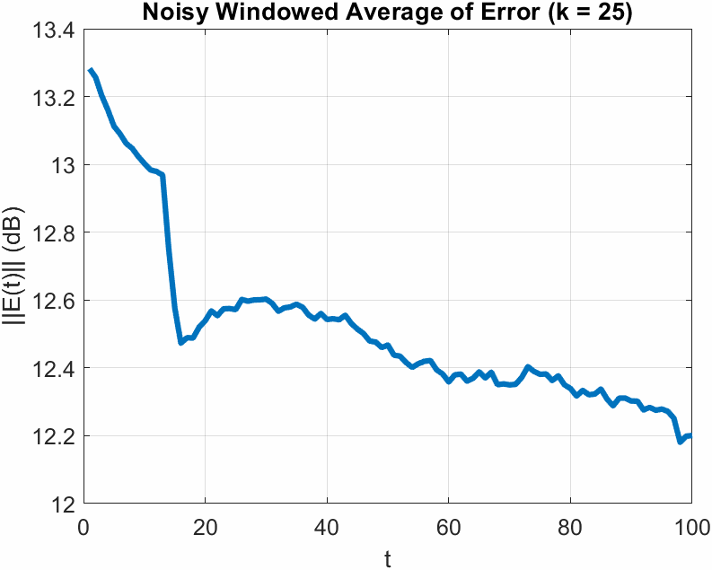
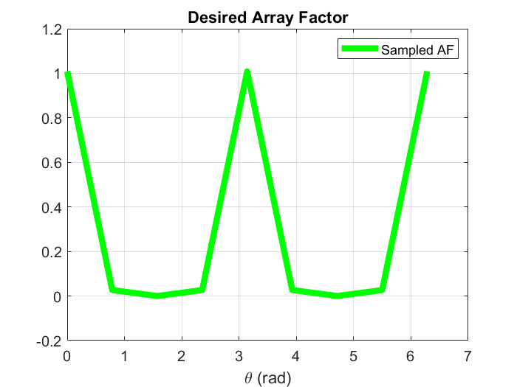
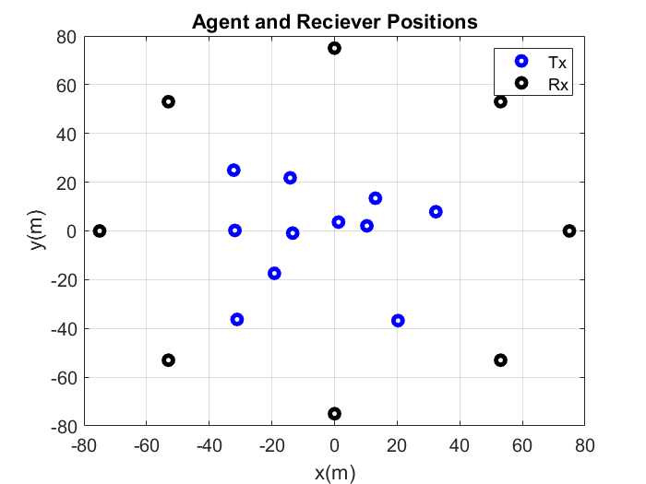
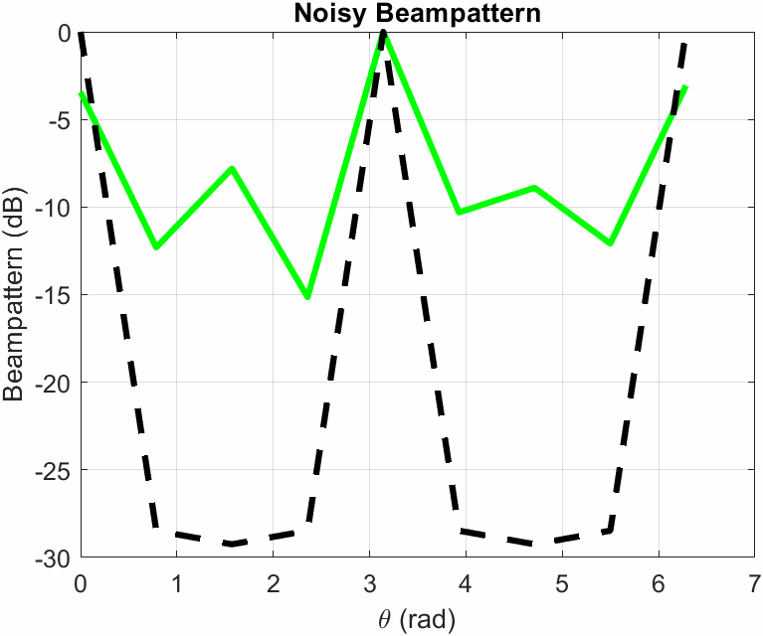
Problem Statement
Given a set of n agents and a desired beampattern sampled at s points, modify agent parameters to reconstruct the desired beampattern

Slide 4
Problem Statement - Assumptions
Transmitters communicate with a central server
There is no transmitter-to-transmitter or transmitter-to-receiver communication (no feedback)
Transmitters are synchronized at the start of a run
No coupling between transmitters

Slide 5
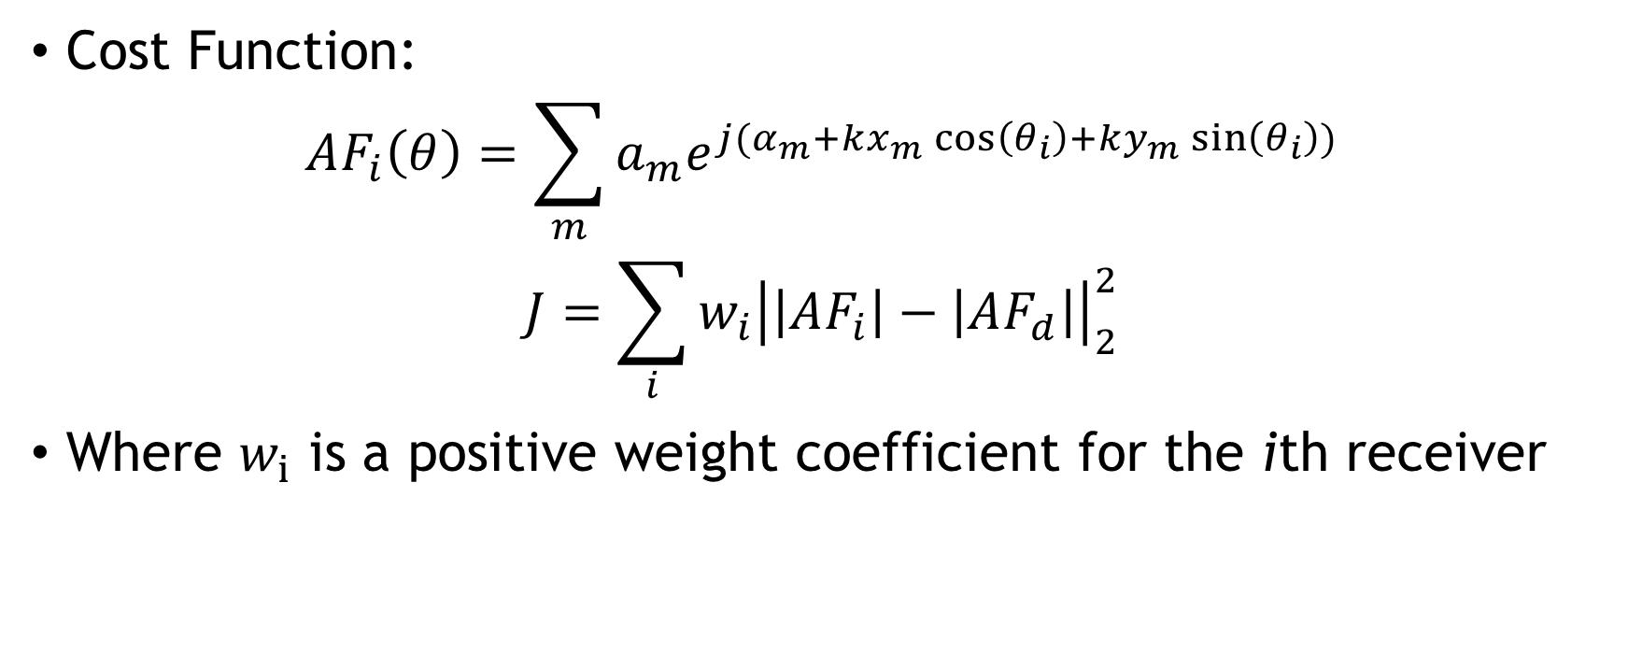
IPG Formulation
Cost Function:
$$AF_{i}\left(θ\right)=\sum_{m}{a_{m}e^{j(α_{m}+kx_{m}\cos\left(θ_{i}\right)+ky_{m}\sin\left(θ_{i}\right))}}$$
$$J=\sum_{i}{{w_{i}\left|\left|AF_{i}\right|−\left|AF_{d}\right|\right|}_{2}^{2}}$$
Where $w_{i}$ is a positive weight coefficient for the ith receiver

Slide 6
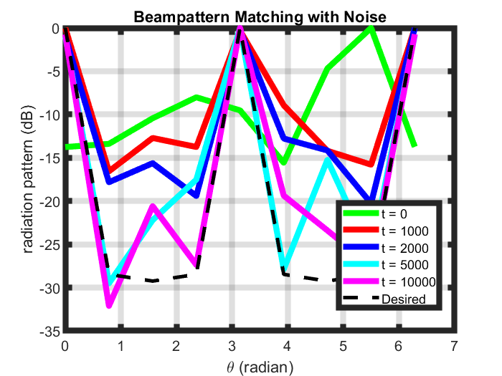
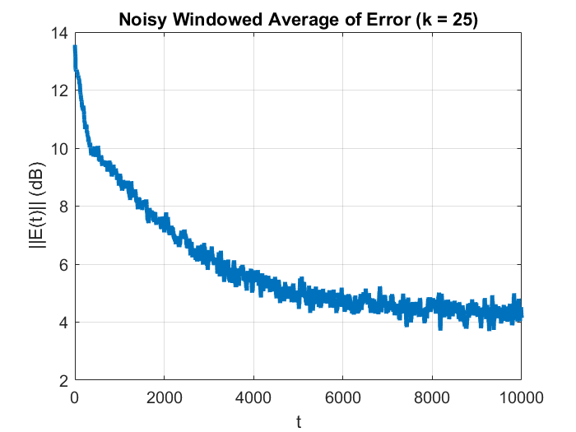
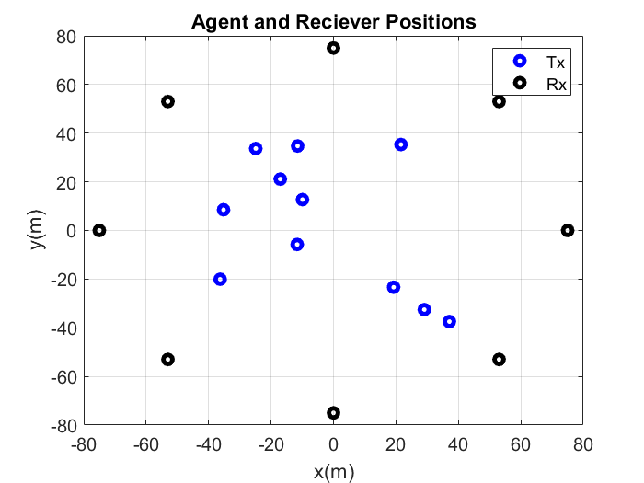
Results for Phase/Amplitude IPG
In this demo we want to demonstrate nullforming
#Tx: 11, #Rx: 9

Slide 7
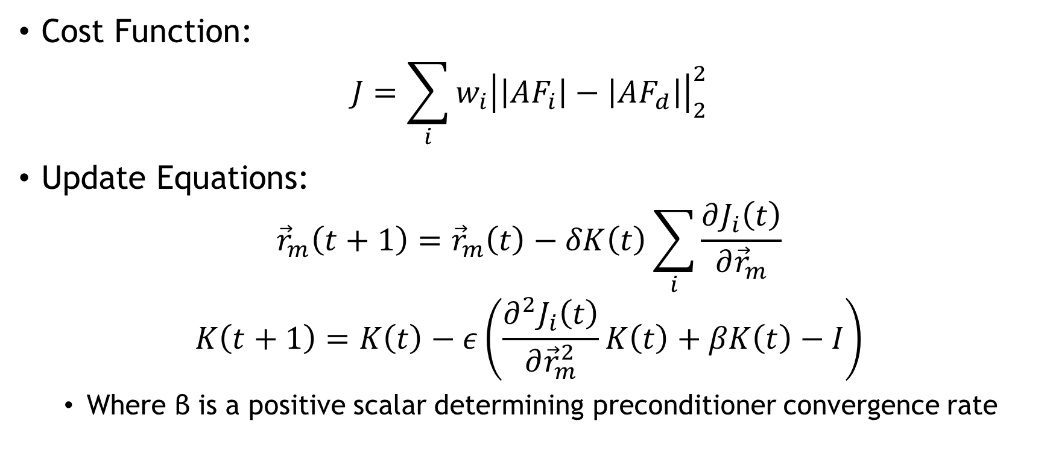
IPG Formulation – Position Optimization
Cost Function:
$$J=\sum_{i}{{w_{i}\left|\left|AF_{i}\right|−\left|AF_{d}\right|\right|}_{2}^{2}}$$
Update Equations:
$${\vec{r}}_{m}\left(t+1\right)={\vec{r}}_{m}\left(t\right)−δK\left(t\right)\sum_{i}{\frac{∂J_{i}\left(t\right)}{∂{\vec{r}}_{m}}}$$
$$K\left(t+1\right)=K\left(t\right)−ε\left(\frac{∂^{2}J_{i}\left(t\right)}{∂{\vec{r}}_{m}^{2}}K\left(t\right)+βK\left(t\right)−I\right)$$
Where β is a positive scalar determining preconditioner convergence rate

Slide 8
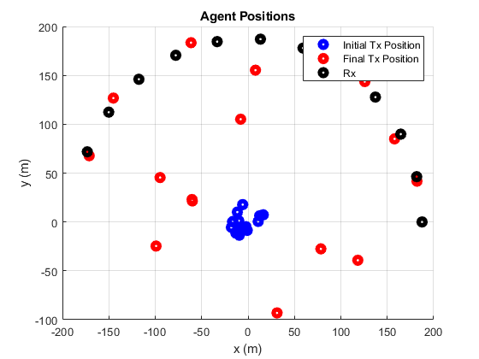
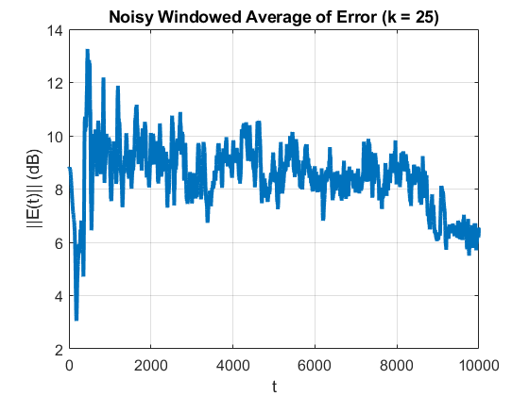
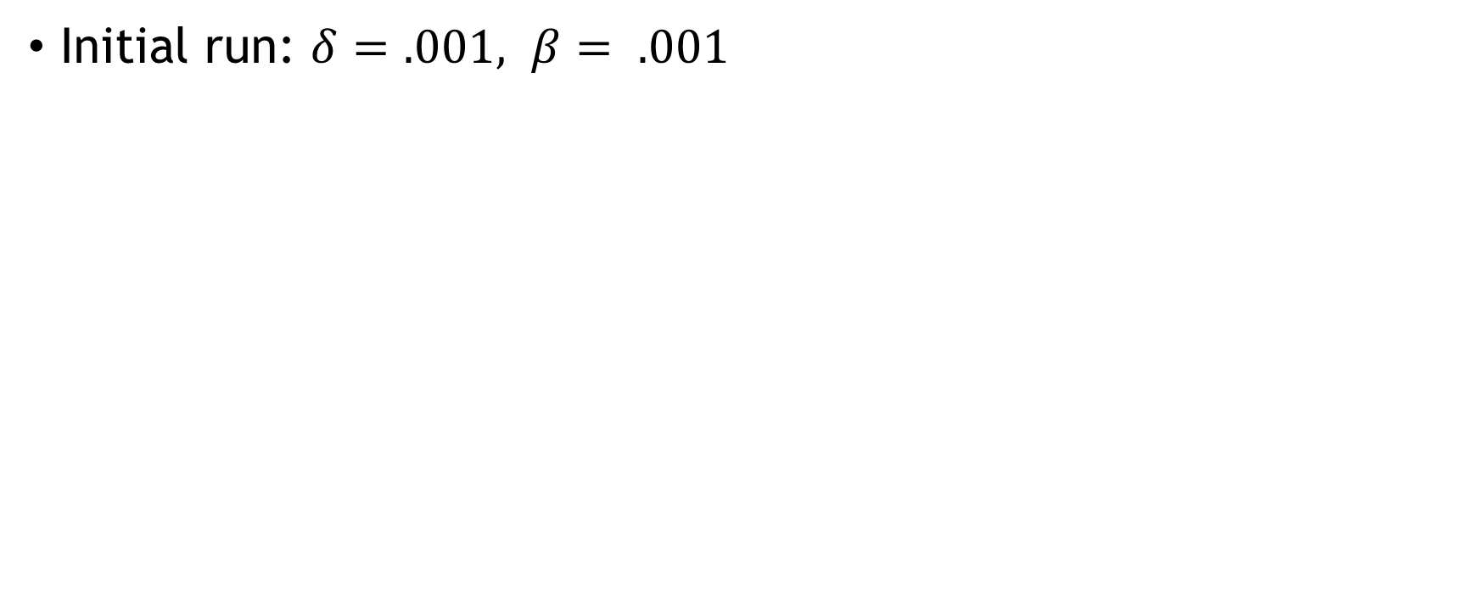
Progress on Position IPG
Initial run: $δ=.001, β= .001$

Slide 9
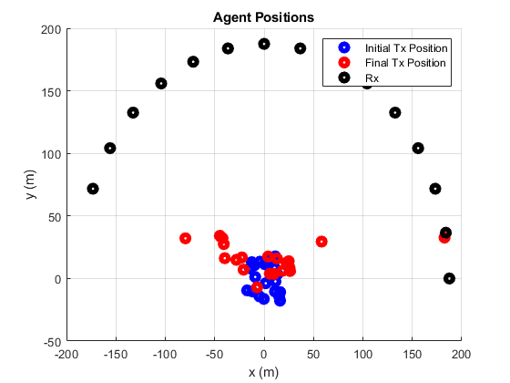
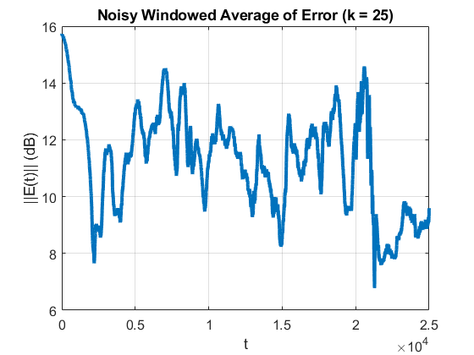
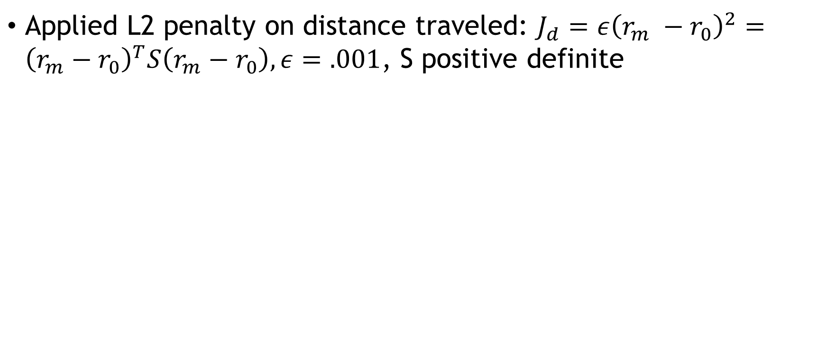
Progress on Position IPG
Applied L2 penalty on distance traveled: $J_{d}=ε{\left(r_{m} −r_{0}\right)}^{2}={\left(r_{m}−r_{0}\right)}^{T}S\left(r_{m}−r_{0}\right), ε=.001$, S positive definite

Slide 10
Future Directions
Including ML approaches to remove unnecessary agents
Improving position optimizer robustness
Intelligent penalties on agent motion
Barrier functions to prevent agents from getting close enough to cause coupling
Iterative Optimization
Running IPG to optimize multiple parameters in sequence

